Slide 1
Chronic kidney disease

Slide 2
Table of contents
01
02
03
Introduction
Methodology
Results
04
Conclusion

Slide 3
01
Introduction
You can enter a subtitle here if you need it

Slide 4
Introduction
Chronic kidney disease remains a significant challenge, as traditional diagnostic approaches heavily depend on laboratory tests and clinical expertise, which may fail to capture subtle early-stage indicators. Machine learning techniques enhance early detection by leveraging patient data to identify disease risk before noticeable symptoms develop. Various ML models have been applied for this purpose, including Logistic Regression, Support Vector Machines (SVM), K-Nearest Neighbors (KNN), Decision Trees, Random Forest, and Gradient Boosting.

Slide 5
Machine learning
Models are trained on labeled data to classify or predict outcomes:
Logistic Regression are Simple models and easy to understand.
SVM tries to separate classes with the best possible boundary.
KNN makes predictions by looking at the most similar data points nearby.
Decision Trees follow a set of rules to classify data.
Random Forest and Gradient Boosting combine many trees to make more accurate predictions.

Slide 6
02
Methodology

Slide 7
Pre-processing
Handling the symbol “?” and replace it with NaN
Features’ Name standardization
Numerical & categorical feature separation
Outlier handling using IQR
Feature Scaling using Z-score Normalization
-Numerical Features: Missing ratio > 50% => Drop Column if < 50% => KNN Imputation -Categorical Features: 2 Unique Values => One-Hot Encoding if > 2 Unique Values => Label Encoding

Slide 8
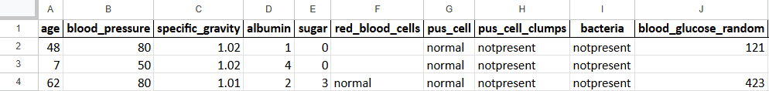
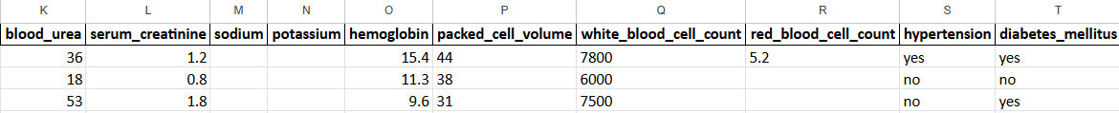
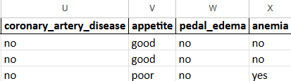

Slide 9
Processing
Dataset was imbalanced
Applied SMOTE to balance classes
Dataset divided to 80%training, 20% testing
Generates synthetic minority samples
Prevents model bias toward majority class

Slide 10
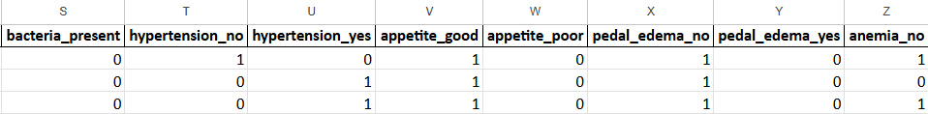
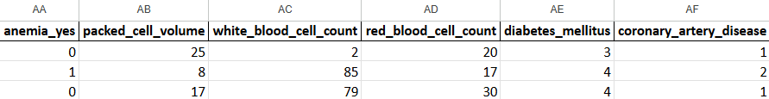

Slide 11
Post-processing
Evaluation after testing:
Accuracy after training
Classification metrics(precision,recall,f1-score,support)
Confusion matrix

Slide 12
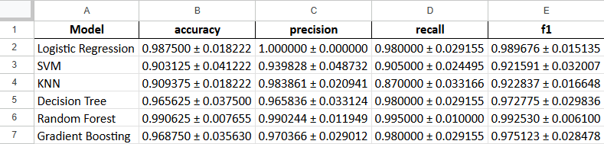

Slide 13
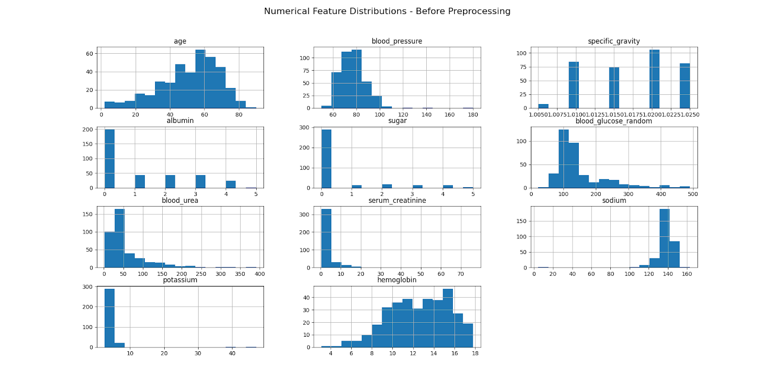
Numerical feature before processing
presents the distribution of numerical features before preprocessing, highlighting skewness and variability across features.

Slide 14
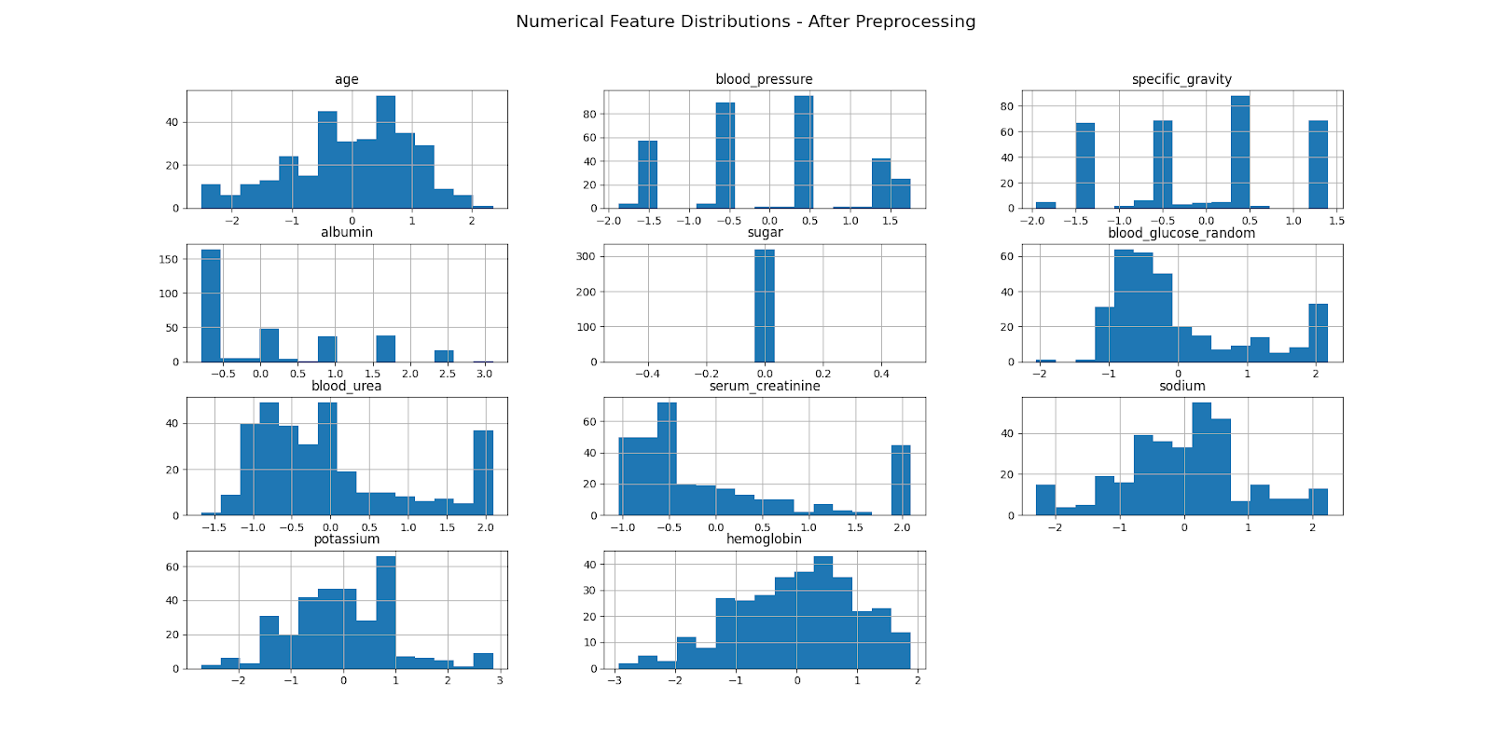
Numerical feature after processing
shows the distributions after preprocessing, where imputation and scaling resulted in more standardized and comparable feature distributions

Slide 15
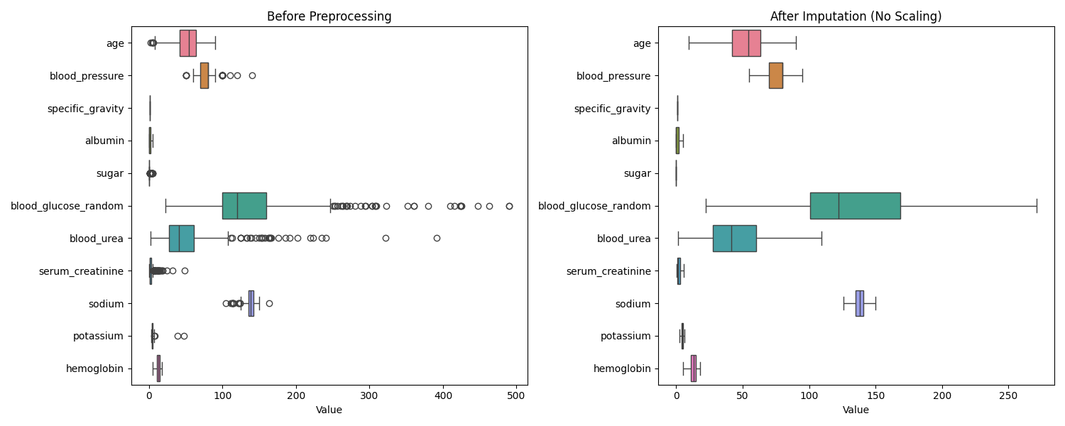
Outliers before preprocessing vs after imputation (no scaling)
illustrates the effect of missing values imputation and applying the IQR method handling without scaling. While extreme values were contained, the original feature scales were preserved

Slide 16
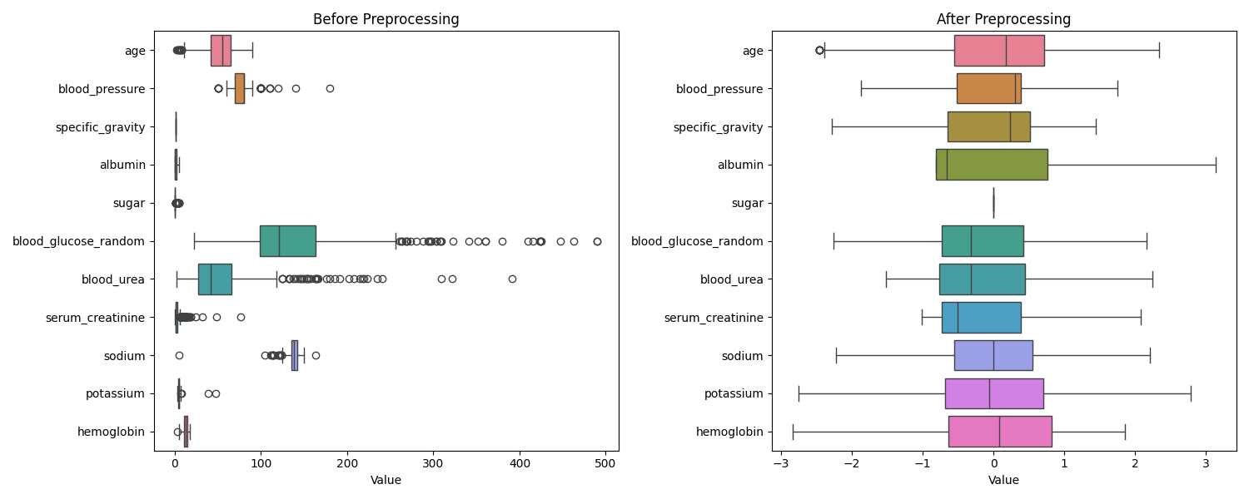
Outliers before and after imputation
shows boxplots of numerical features before preprocessing that results in extreme values and after preprocessing shows using the method of IQR Remover and scaling with the z-score normalization that results in small range of values.

Slide 17
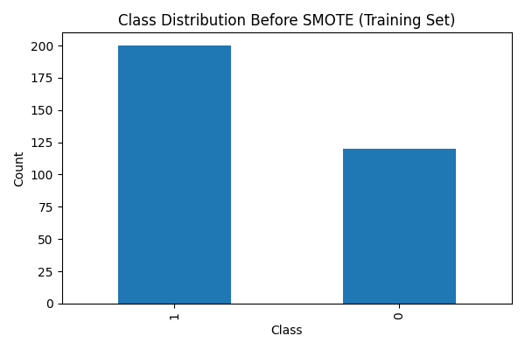
Class distribution before SMOTE
displays the class distribution of the training dataset indicating unbalancing and needs to be balanced.

Slide 18
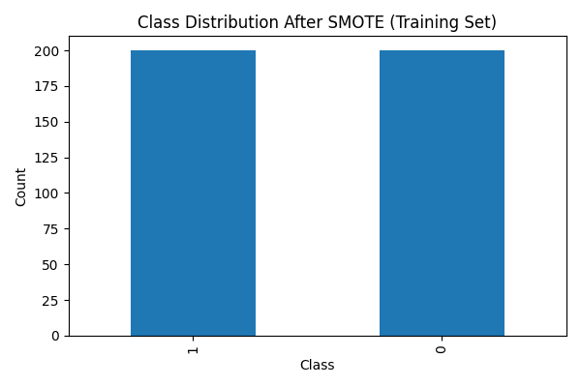
Class distribution after SMOTE
shows the class distribution after applying SMOTE and balancing the classes.

Slide 19
03
Results

Slide 20
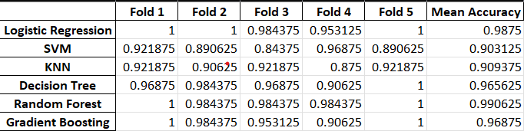
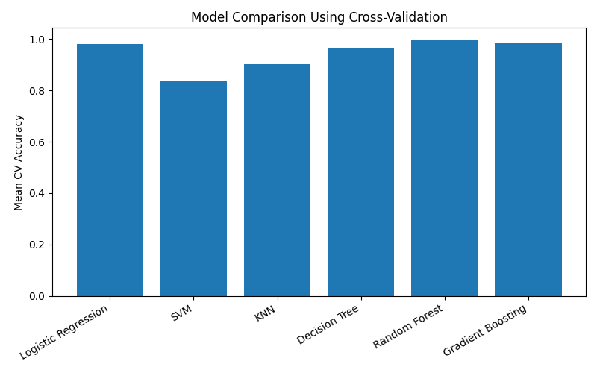
Model comparison using cross-validation
compares the mean cross-validation accuracy of difference machine learning models evaluated using
five-fold stratified cross validation.

Slide 21
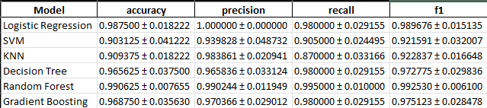
Train metrics
CV Results

Slide 22
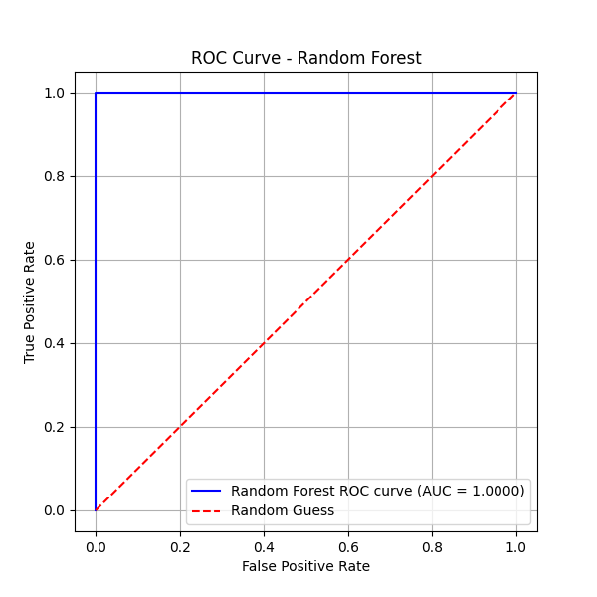
Random Forest curve
achieving an AUC of 1.00, which indicates a perfect discrimination between classes compared to random guess.

Slide 23
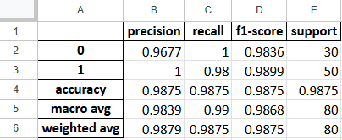
Classification Report
shows strong model performance, with high precision, recall, and F1-scores for both classes. The overall accuracy is 98.75%

Slide 24
04
Conclusion

Slide 25
Conclusion
This project presented a machine learning framework for early prediction and stage-wise classification of Chronic Kidney Disease (CKD) while addressing key clinical data challenges. A sequential preprocessing pipeline improved data quality and model reliability. Random Forest achieved the best predictive performance among the evaluated models. The results confirm the potential of machine learning for effective early CKD screening and decision support.

